Slide 1
PHP Language Intro
Reading material for PHP:
http://www.w3schools.com/php/default.asp
CS/IT 490 WD, Fall 2013

Slide 2
Breakdown
What is PHP?
Includes
Variables and Arrays
Echo and Print
Useful PHP Functions
String Manipulation
Operators
Control Flow

Slide 3
What is PHP?
PHP is a server-side scripting language.
Similar to other programming languages, it can open files and databases, and perform various functions.
PHP also has a set of functions to make things easier
  e.x.: Explode

Slide 4
What is PHP?
A .php file can contain only PHP code, or it can contain a full XHTML webpage, with bits of PHP commands thrown in.
To begin writing PHP, it must be contained within:
<?php /* command */ ?>
Or
<? /* command */ ?>

Slide 5
Includes
Just like in Python where you can import other libraries and code, and C++ where you #include other libraries and code,
You can use the include and include_once statements in PHP to include other .php files.
If your .php file contains XHTML, that XHTML will be inserted into the page at the point you are using the include.

Slide 6
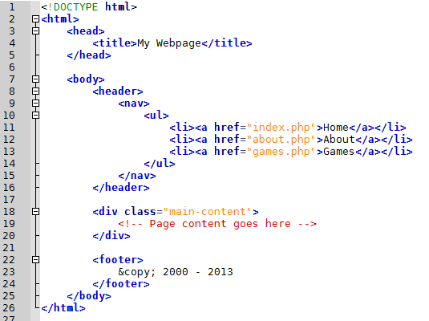
Includes
A full webpage, with the required XHTML tags, a <header>, <div class=”main-content”>, and <footer>.
We can split up the three main sections...

Slide 7

Includes
Old page
The new page only contains this

Slide 8
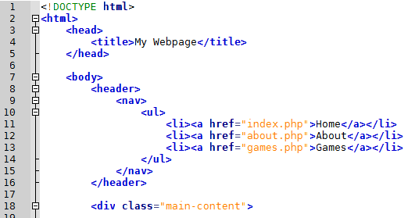
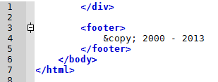
Includes
header.php
footer.php
index.php

Slide 9
Includes
Generally, use include_once instead of include.
This ensures that if a file is included multiple times, the only time it's copied over is the first time.
This keeps “duplicate” variables, functions, and classes from being declared.

Slide 10
Variables and Arrays
Variables in PHP start with a dollar sign: $
<? $username = "bob"; ?>
Arrays must be first declared like this:
<? $userInfo = Array(); ?>

Slide 11
Variables and Arrays
You don't need to declare a variable before using it, and you don't need to specify a data-type.
But there are still different datatypes:
  Strings: enclosed in double- or single-quotes.
  <? $url = "http://www.asdf.com"; ?>
  <? $name = 'claire'; ?>

Slide 12
Variables and Arrays
Integers:
<? $age = 54; ?>
Floats:
<? $price = 19.95; ?>
Booleans:
<? $isLoggedIn = false; ?>
NULL:
<? $userLogin = null; ?>
Objects:
  We can declare and instantiate classes in PHP, which we will go over later.

Slide 13


Variables and Arrays
Arrays are Associative Arrays
If you just store a series of values, the keys are the indices in order:

Slide 14

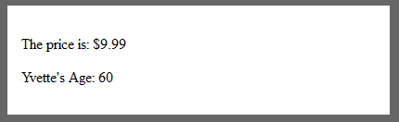
Variables and Arrays
You can also specify the key-value pairs:

Slide 15
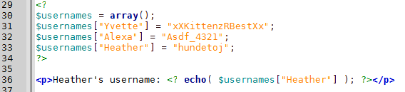
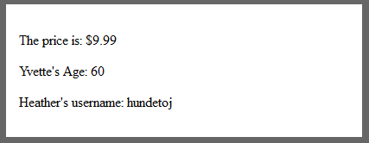
Variables and Arrays
Another way to declare a key-value pair:

Slide 16
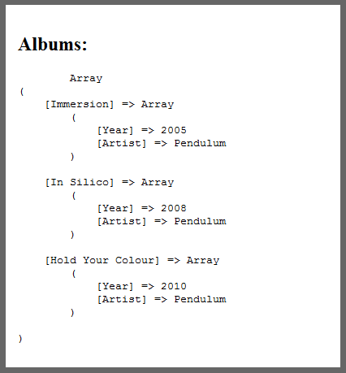
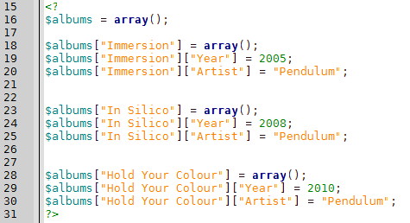
Variables and Arrays
Array values can also contain additional arrays, to make a hierarchy:

Slide 17

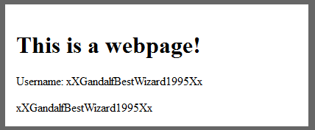
Echo and Print
If you want to print text into the HTML page through PHP, you can use echo:

Slide 18
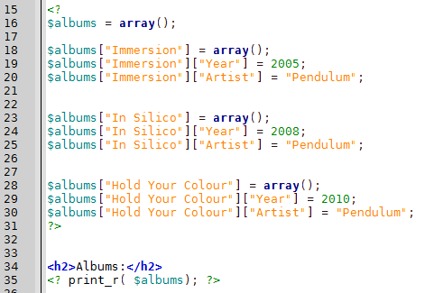
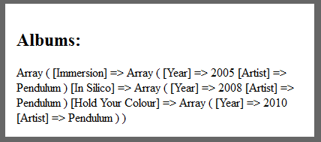
Echo and Print
If you want to print out all the contents of an array, you can use print_r:

Slide 19
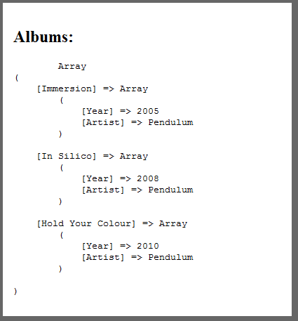
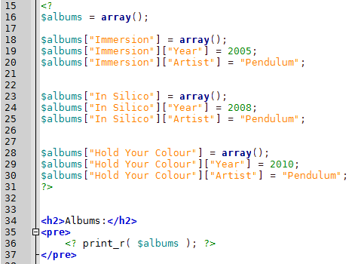
Echo and Print
Tip: The array printout looks nicer if you enclose it within <pre> tags. This can be useful for debuggng.

Slide 20

Echo and Print
The short-hand for Echo is to use an equal sign =
Good for subbing in names within your HTML pages.

Slide 21
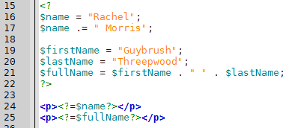
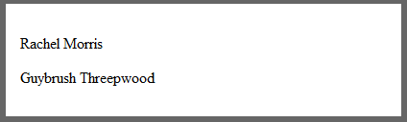
String Manipulation
In PHP, to concatenate two strings you use the period . Operator.
  Don't get it mixed up with +! + will not concatenate your strings!

Slide 22
String Manipulation
PHP has some handy functions for you to play with strings with:
explode( $delimiter, $string )
Splits a string by the delimiter specified
http://php.net/manual/en/function.explode.php
str_getcsv()
Turns a .csv string into an array
http://www.w3schools.com/php/func_string_str_getcsv.asp
str_replace( $search, $replace, $text )
Replaces any occurrences of [$search] with [$replace]
http://www.php.net/manual/en/function.str-replace.php

Slide 23
String Manipulation
strtoupper( $string ) and strtolower( $string)
Set to upper/lower case
http://www.php.net/manual/en/function.strtoupper.php
http://www.php.net/manual/en/function.strtolower.php
trim( $string )
Removes any whitespace before the first character and after the last character.
http://www.php.net/manual/en/function.trim.php
strpos( $haystack, $needle )
Find the position of a substring
http://php.net/manual/en/function.strpos.php

Slide 24
String Manipulation
The problem with strpos
  It returns the position index of a substring.
  What does it return if that substring is not found?
  False = 0, but that's also a position!

Slide 25
String Manipulation
The problem with strpos
  To check if a sub-string (needle) is not in the string (haystack), you need to use the === or !== operators:

Slide 26
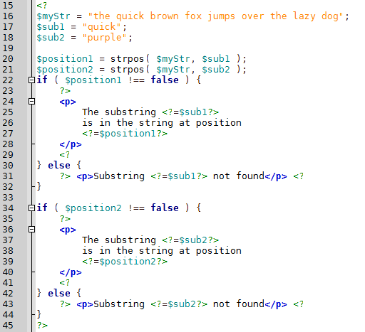
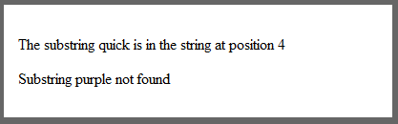
String Manipulation

Slide 27
String Manipulation
We will also talk about the tag & slash stripping functions when we get to string sanitation.

Slide 28
Operators
PHP has your standard math operators:
Operator | Example
Addition + | $num1 + $num2
Subtraction - | $num1 - $num2
Multiplication * | $num1 * $num2
Division / | $num1 / $num2
Modulus % | $num1 % $num2
You can also use +=, -=, *=, /=, etc.

Slide 29
Operators
The assignment operator is the same as C++:
$x = 3
Concatenation uses a period .
$employee .= " (fired)";
Increment and decrement are like C++:
$i++; ++$i; $i--; --$i;
http://www.w3schools.com/php/php_operators.asp

Slide 30
Operators
Equality operator: ==
Identical operator: ===
This will return true if the left hand equals the right hand, and they are the same type.
Not Equal: != and <>
Not Identical: !==
http://www.w3schools.com/php/php_operators.asp

Slide 31
Operators
Comparison: < <= > >=
Logical operators:
&& or and
|| or or
! not
http://www.w3schools.com/php/php_operators.asp

Slide 32
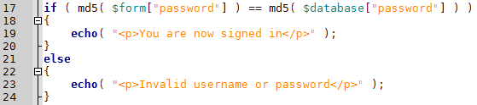

Control Flow
PHP has your standard if / else / else if statements:
Else if is written as elseif though:

Slide 33
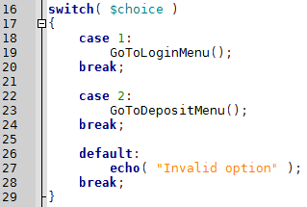
Control Flow
The Switch statement is available:

Slide 34
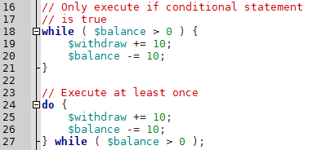
Control Flow
While and Do While loops:

Slide 35
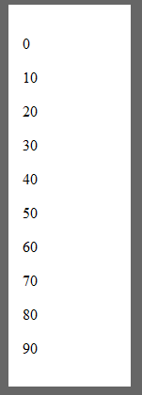

Control Flow
For Loops:

Slide 36
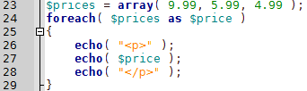
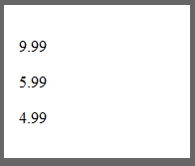
Control Flow
For Each loops
See also http://www.w3schools.com/php/php_looping_for.asp
Lets us signify each element of the array with the $price variable name, so we don't have to mess with indices.

Slide 37
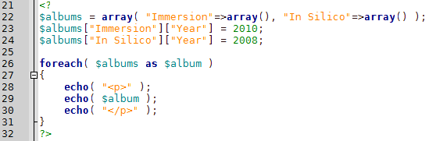
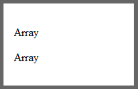
Control Flow
For Each loops
See also http://www.w3schools.com/php/php_looping_for.asp
Array
Notice that echo just shows “Array”. You can print arrays with print_r.

Slide 38
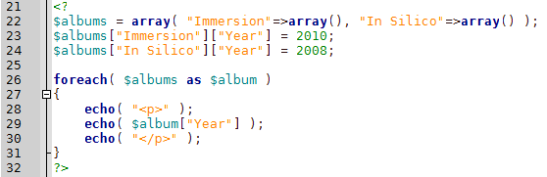
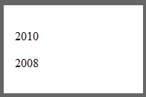
Control Flow
For Each loops
See also http://www.w3schools.com/php/php_looping_for.asp
We can access members of the sub arrays

Slide 39
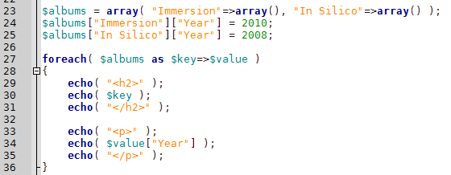

Control Flow
For Each loops
See also http://www.w3schools.com/php/php_looping_for.asp
Can get the key and value within the foreach loop.
This is the most handy

Slide 40

Useful PHP Functions
You can print out the date with the date() function.
You supply a string, which has symbols to represent what format we want for our timestamp.
See http://php.net/manual/en/function.date.php for the different options.

Slide 41
Useful PHP Functions
More later...

Slide 42
References
-

